Slide 1
If the paddler is always right? Tourism quality system "Q Latvia". The salt and sugar of "Mystery shopping" experiment in the Riverways project and entrepreneurs training in Latvia.
Mg.soc.sc.Ilze Grīnfelde,
lecturer of tourism studies, Vidzeme University of Applied Sciences, Latvia
haapsalu,
26.05.2015.

Slide 2
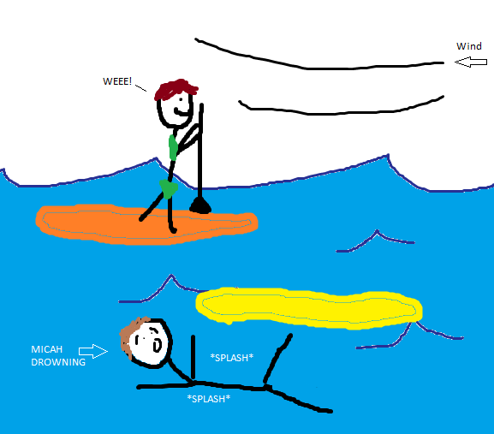

Slide 3
So we begin
Q Latvia awarding (Q Latvia commission)
Evaluation of quality (Administrating institution of Q Latvia, «Mystery shopper»)
The Plan
Services (all chain)
Client satisfaction level research
Personell management
Client complaint management
Cooperation with other companies
Specialist of quality of Q Latvia
Decision and application for Q Latvia
Notes:
Īsi par to – kas mēs esam un kāpēc te esam. Īsi bez detaļām par slepenā viesa testu. Dalībnieki – īsi par sevi.

Slide 4
The growth chart for water-tourism entrepreneur
Strengthening of loyality of recent clients
Enlargement of the amount of clients, creation of loyality
New products and services
New target markets – external (not only clients, but partners)
Excellence in service stimulates
Loyality
Repeated deals
Attracts new clients
(TNS, Klientu apkalpošanas kvalitātes novērtējums, 2014)

Slide 5
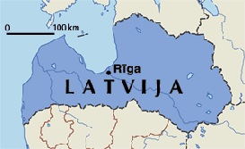
Mystery shopper process
- service
-sales
- environment
30
May-June 2014
- time management
- service skills
- communication
- outfit/uniforms/behaviour
- information
Inventory and payment
subjective evaluation

Slide 6
Mystery shopper results
Result explanation
0 – 50 poor;
50 – 70 average;
70 – 90 good;
90 – 100 excellent
~70%
Improvements needed
!!!

Slide 7
Mystery shopper results
68% | 50% | 81% | 73%
The most specific problems: beginning of phone conversation, clarification about experience and specific needs, information about the person in charge, waiting time for e-mail response, e-mail content in general, languages in website, feedback options, informative materials, inventory
Info and advice regards responsible attitude towards nature
Safety information, instructions
Payment documents, agreements

Slide 8
Some client comments
All in all – friendly and correct attitude towards client. The feeling that you are welcome for repeated visit.
Nice and hospitable hosts who gave us boats. For example my husband got the headache and they provided the pills.
Well managed trip. Good timing and clear instructions.
The employee was so enthusiastic, communicable and willing to tell about anything we asked.
Very open serviceman. We got rich information about the nature, sites and other. Very positive trip there and back.
The employee has forgotten about the route we agreed on the phone, at the result client did not reached planned destination because the trip started in wrong place.
Well – almost good, however – this is not very nice that the promised bill we did not received. No any documents – agreement, bill or anything regards inventory.
There should be more awareness towards safety, did not received any information.
Please inform non experienced clients about anything – how to paddle, what to do in case of over and so on.
I would be happy if anyone would meet and greet me and at the end I missed «good-bye and see you next year»!

Slide 9
The seminar results
3/~50
If implementation of the quality standard does not make all the products too similar and boring?
If criteria measured are really important for client?
If the high quality standard is not important only in case of foreign clients?
If the client is not the main responsible for the result?
If the safety information would not scare teh client?
Do we have to have all the clients?
Causes of problems:
-capacity
- seasonality
- priorities
- management skills
-partners and subcontractors
- perception of client (judging)
- demand during the season exceeds offer

Slide 10
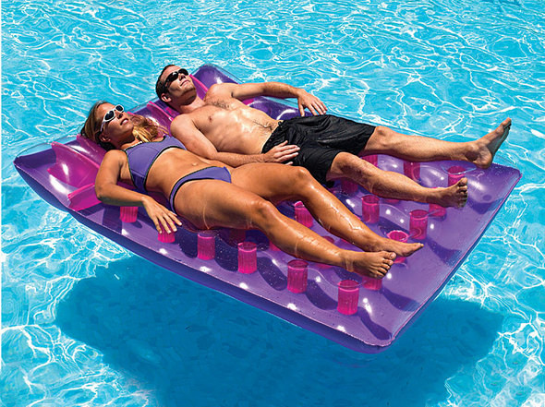
And in the conclusion...

