Slide 1
Development of water tourism as nature and active tourism component in Latvia and Estonia
Summary of the Project results
Aiga Petkēvica, Riverways project manager
May 26, 2015
Hapsalu, Estonia
Notes:
1

Slide 2
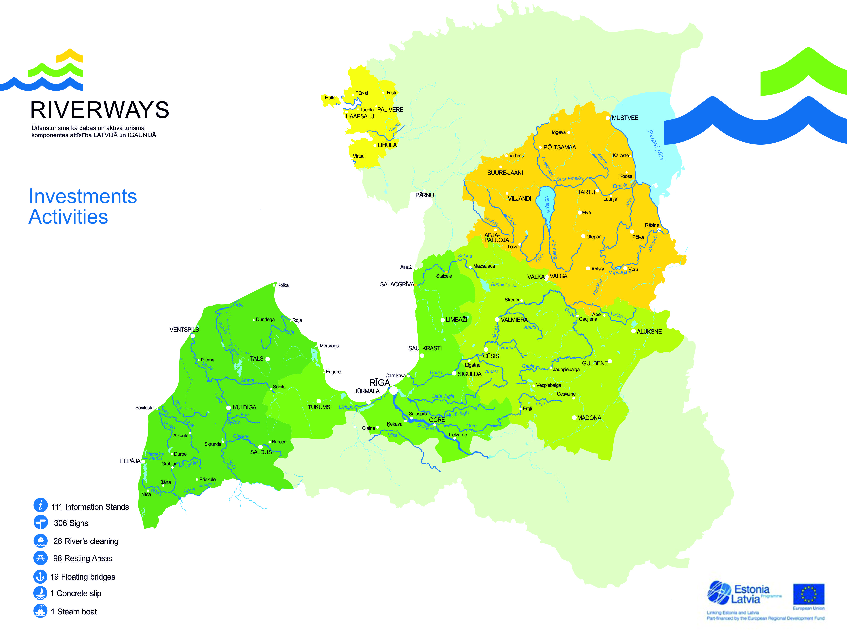
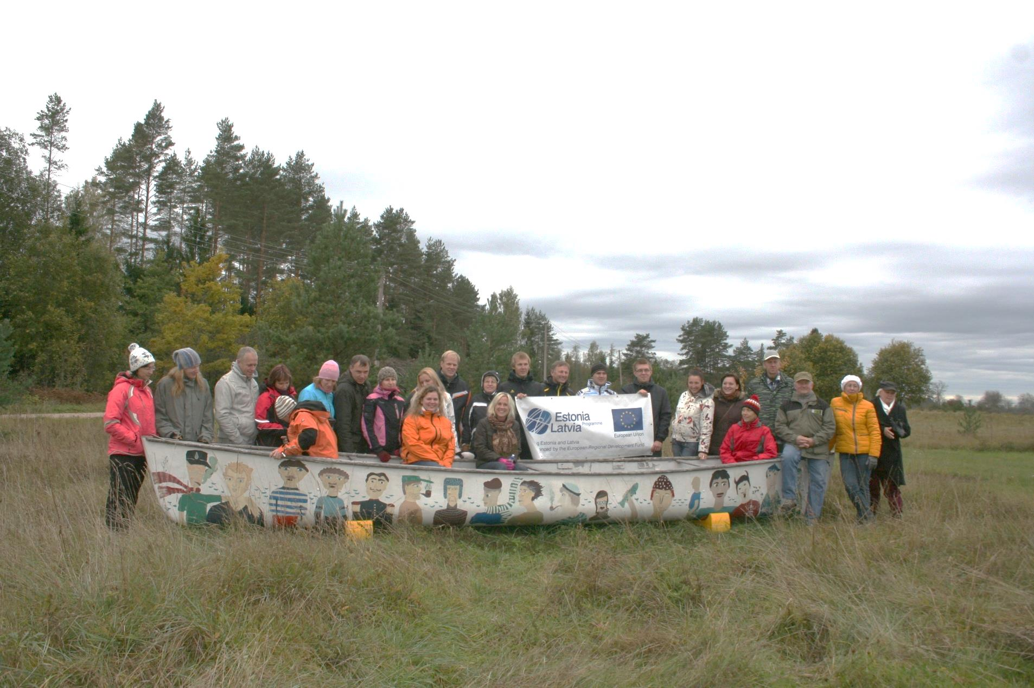
Riverways
Estonia – Latvia Cross-border Cooperation Programme 2007 – 2013
2,5 years
2 168 674,70 EUR, incl.:
1 800 000 EUR supported from EU and
386 674,70 EUR - Partners contribution
39 partners, incl.:
9 from Estonia and 30 from Latvia, covering: Vidzeme, Rīga, Kurzeme regions, South-Estonia and Lääne county;
tttttttttttttttttttttttttttttttttttttttttttttttttt

Slide 3
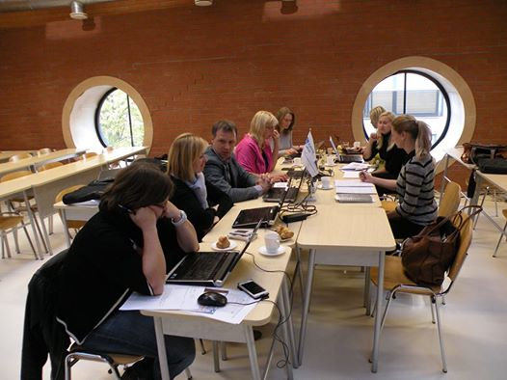
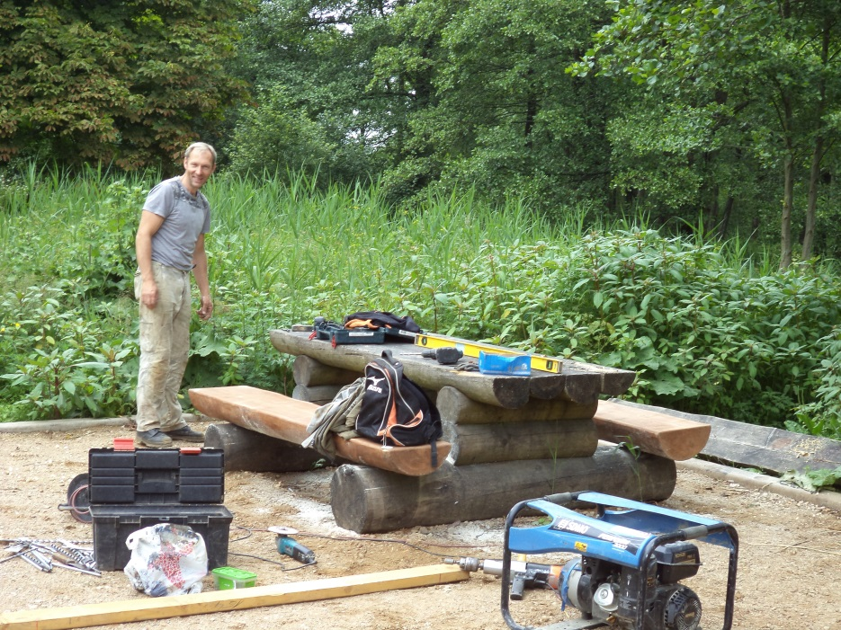
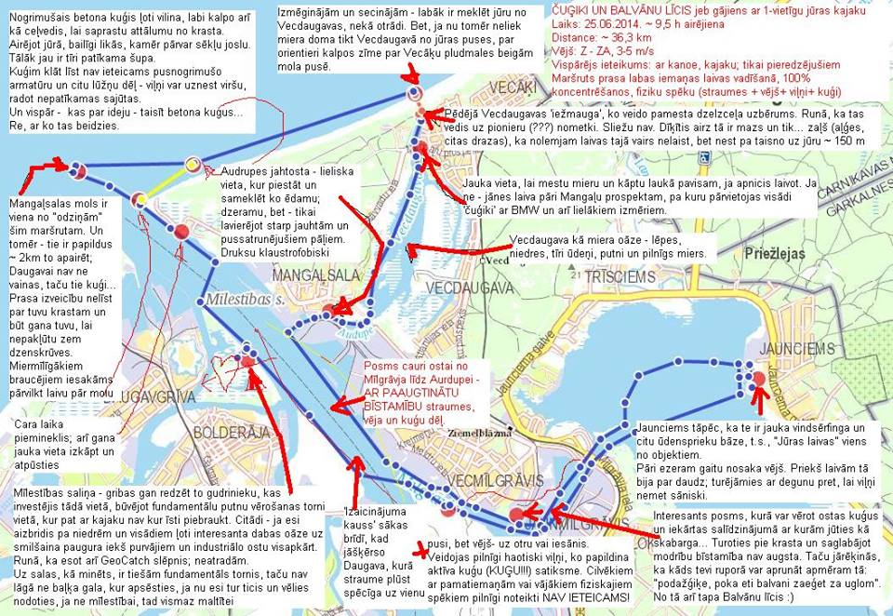
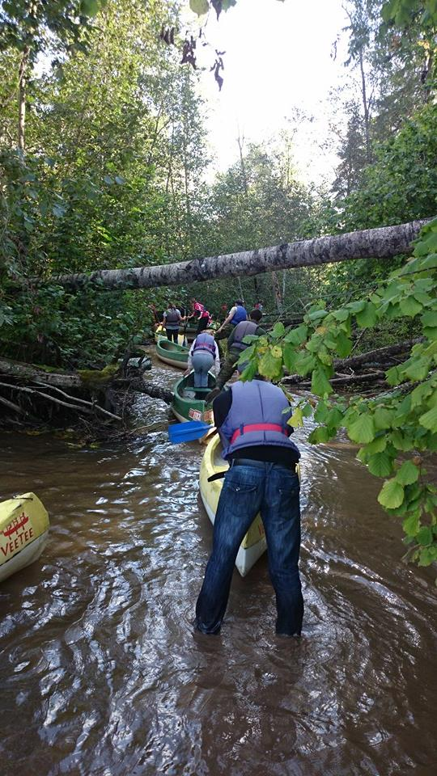
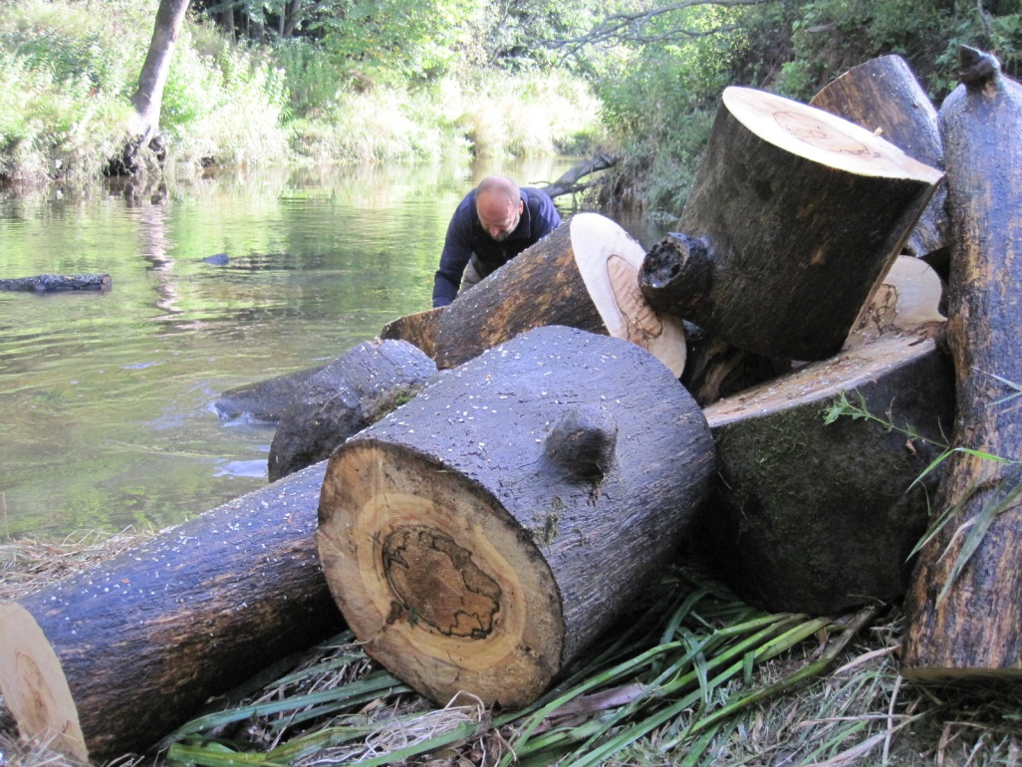
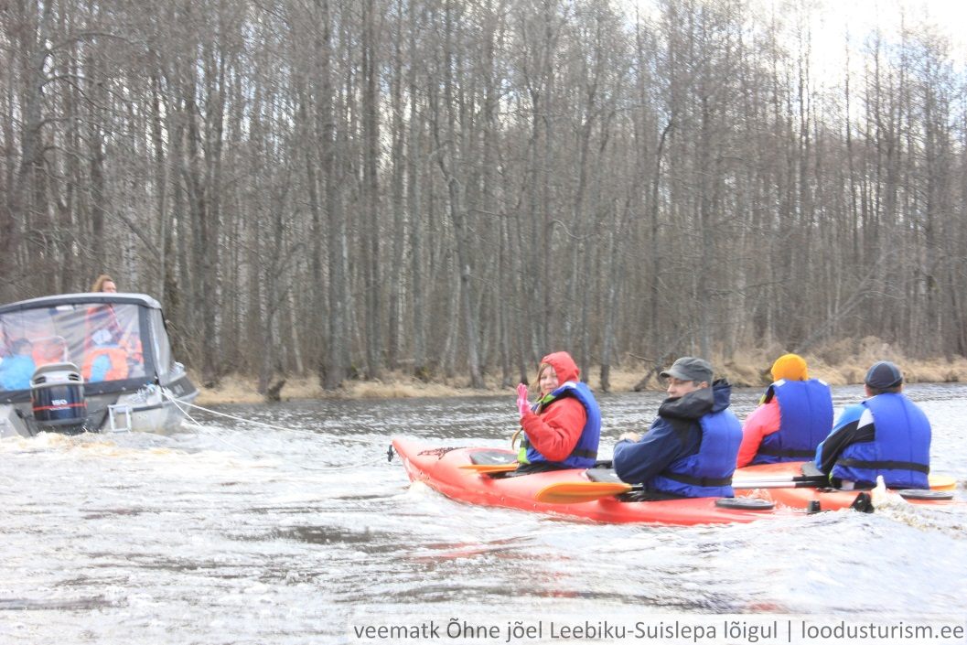
RIVERWAYS
Promoting watertourism
Building infrastructure
Product development and cooperation

Slide 4
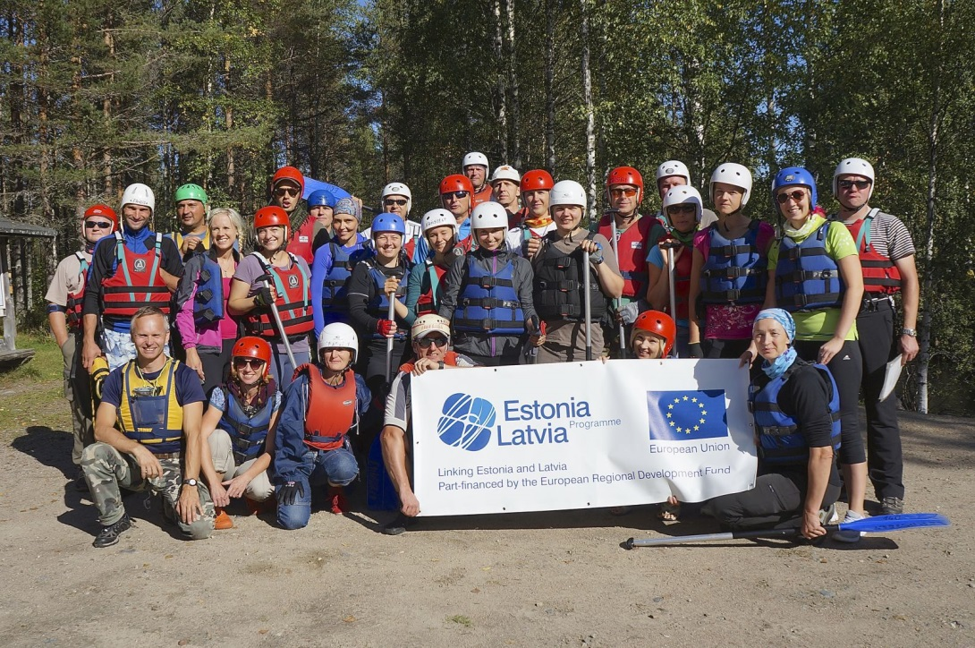
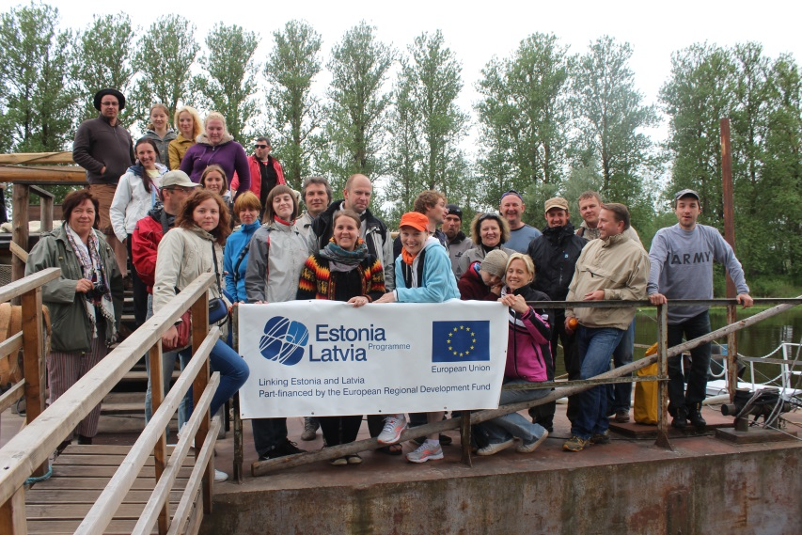
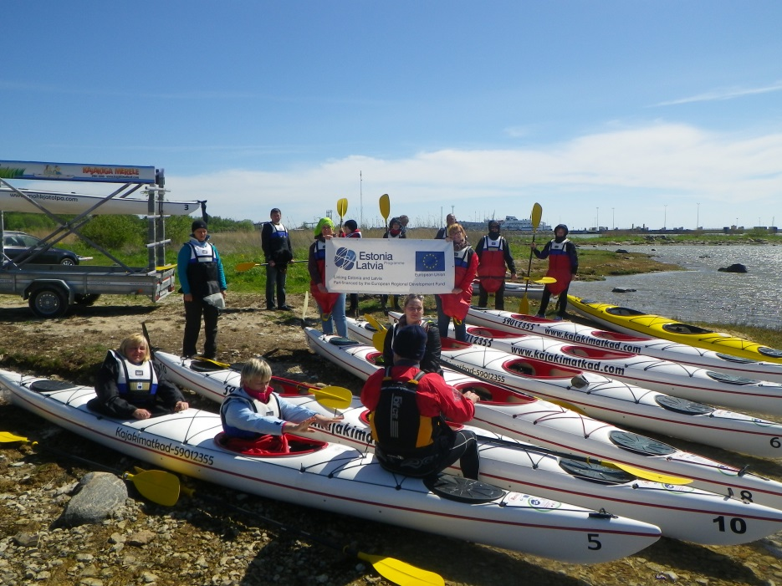
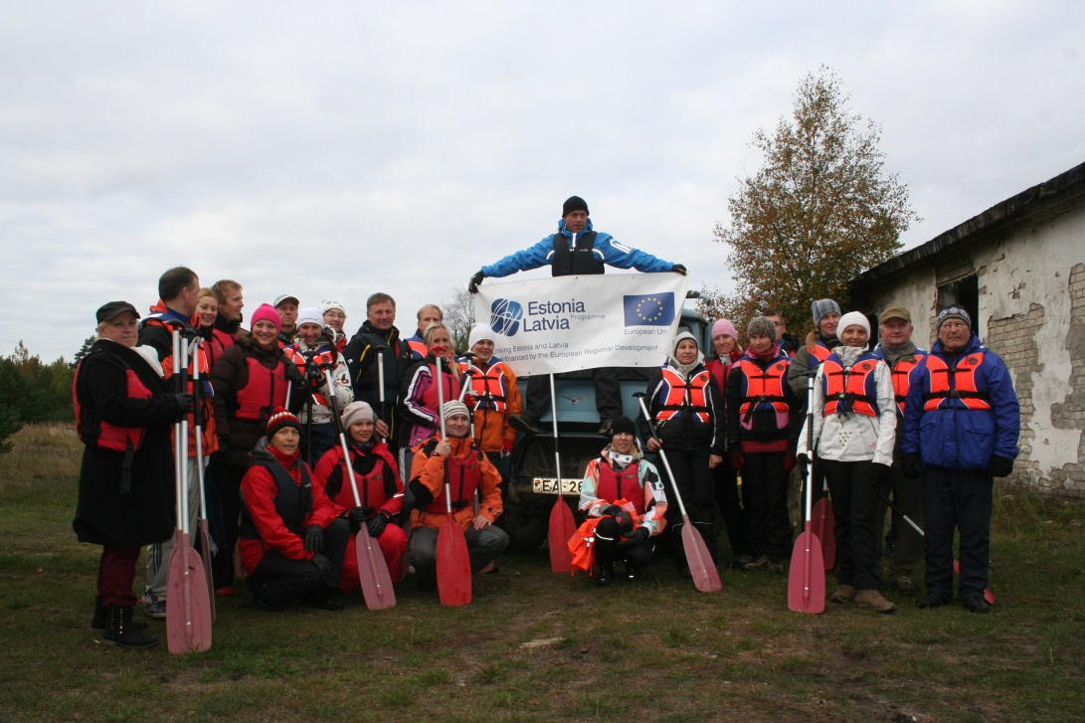
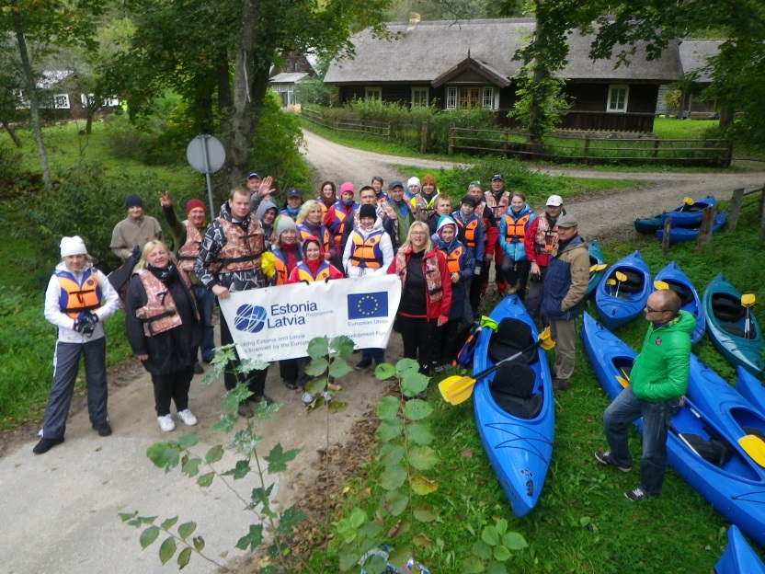
EXCHANGE VISITS
4 visits to explore neighbouring countries experiences in water tourism development:
Finland
Latvia
Estonia
Lithunia

Slide 5
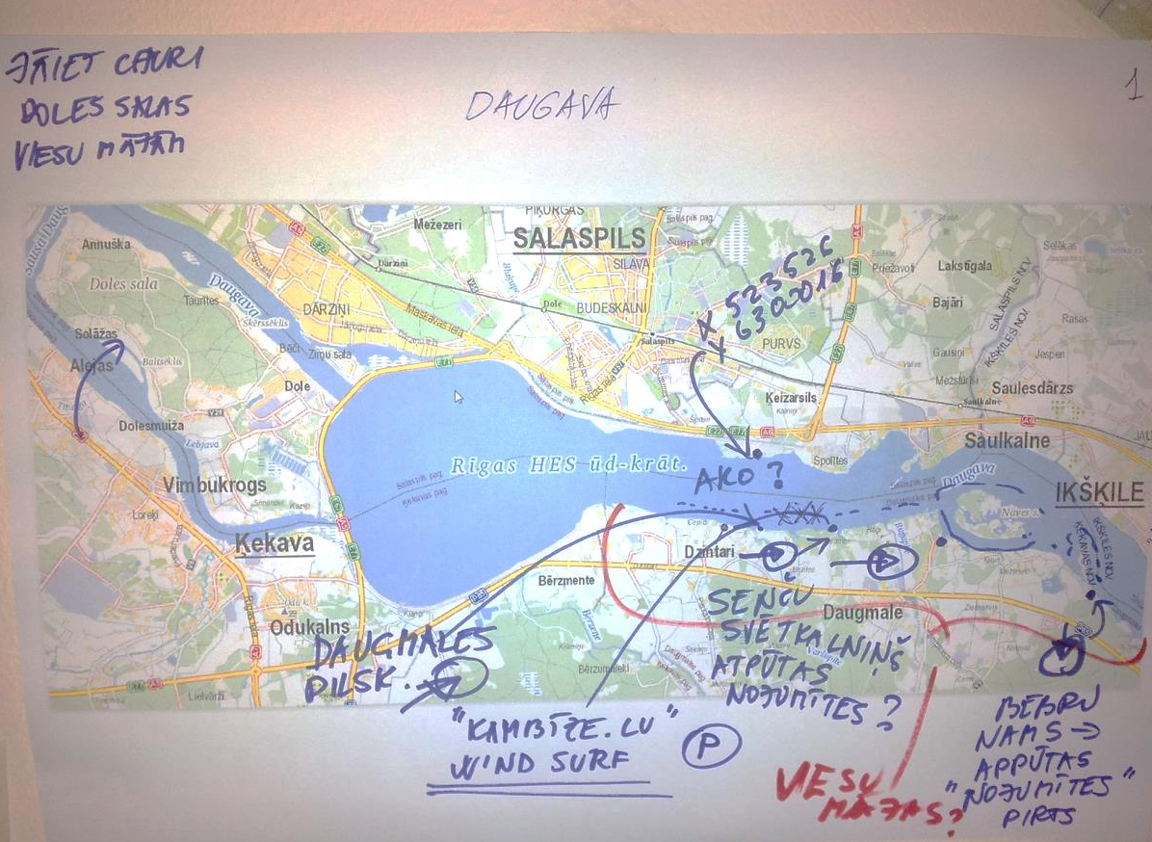
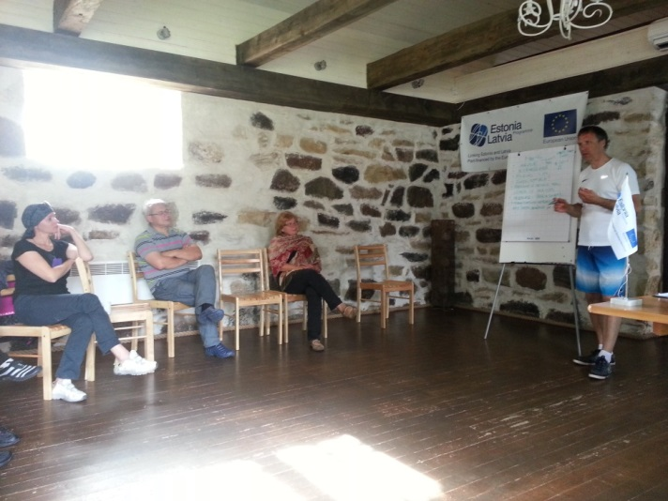
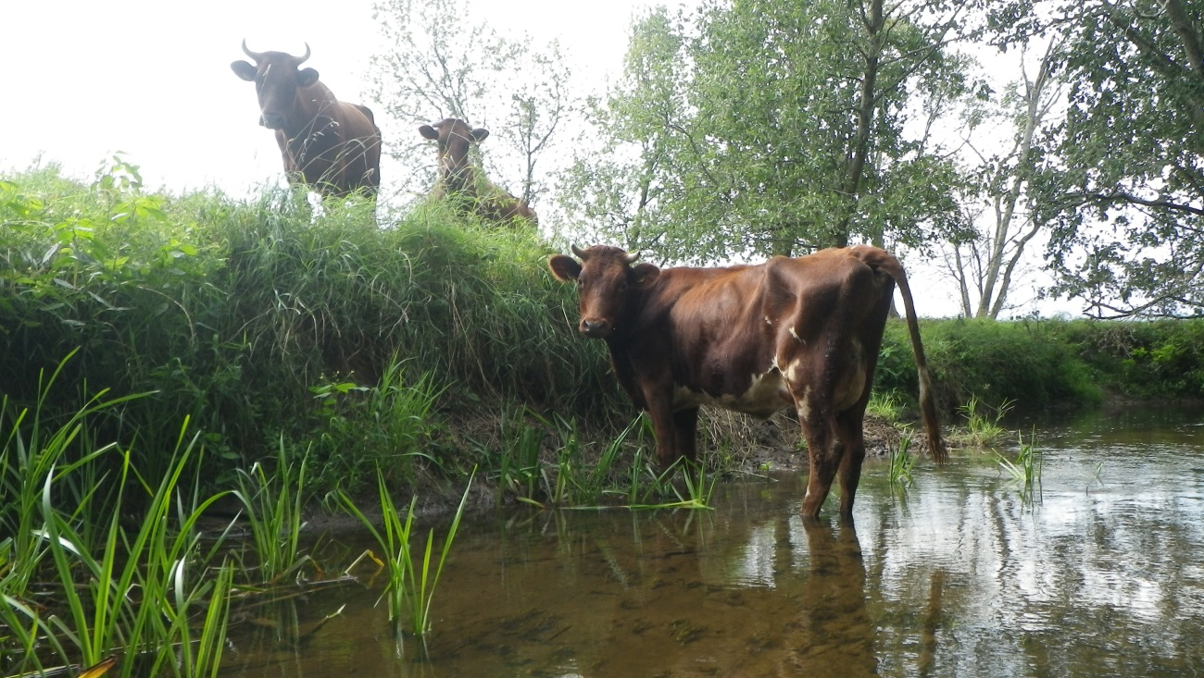
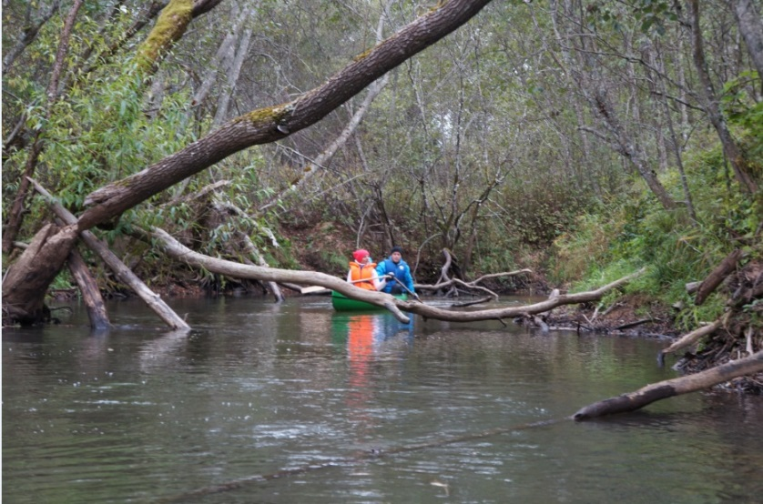
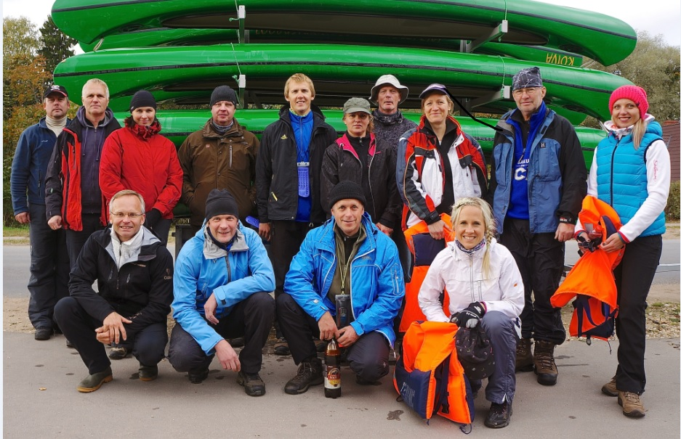
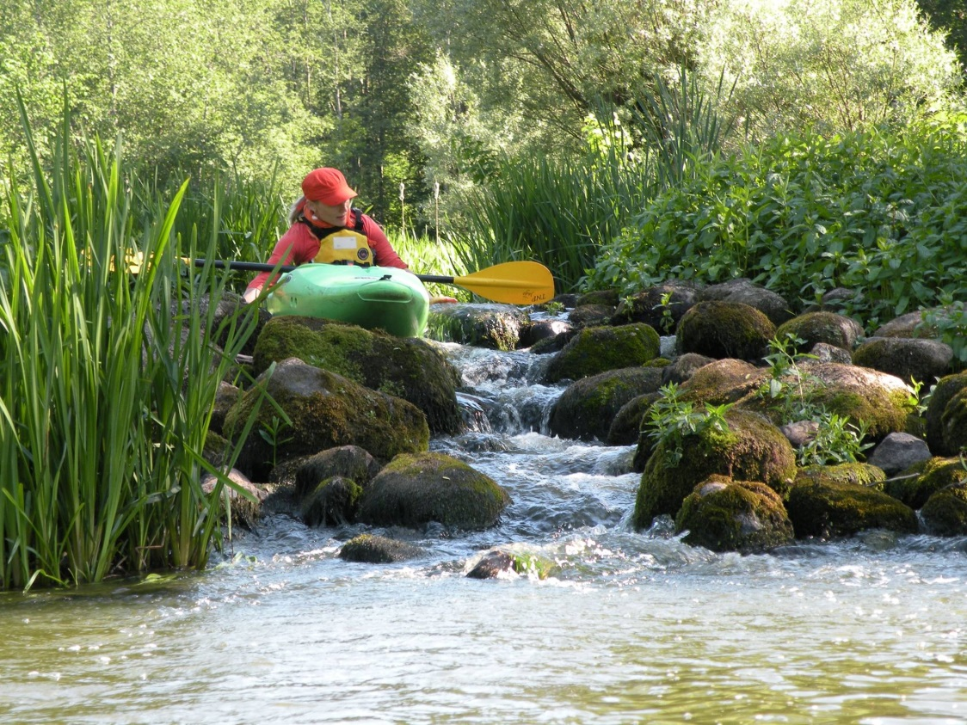
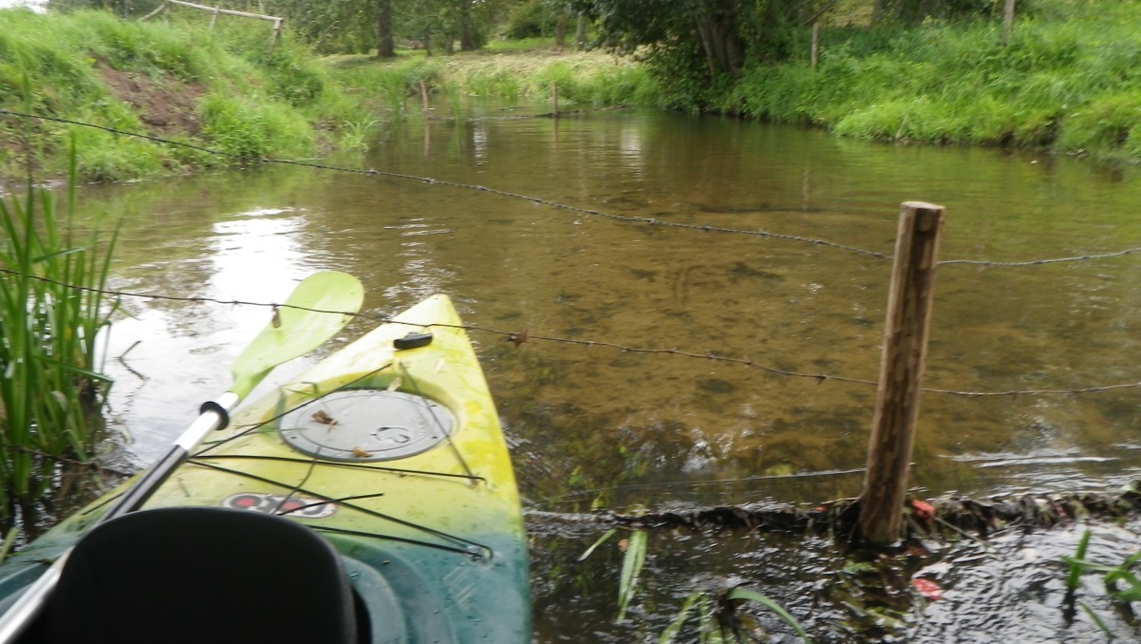
Expeditions
~ 26 events
~ 270 participants
More than 430 km canoeing and kayking

Slide 6
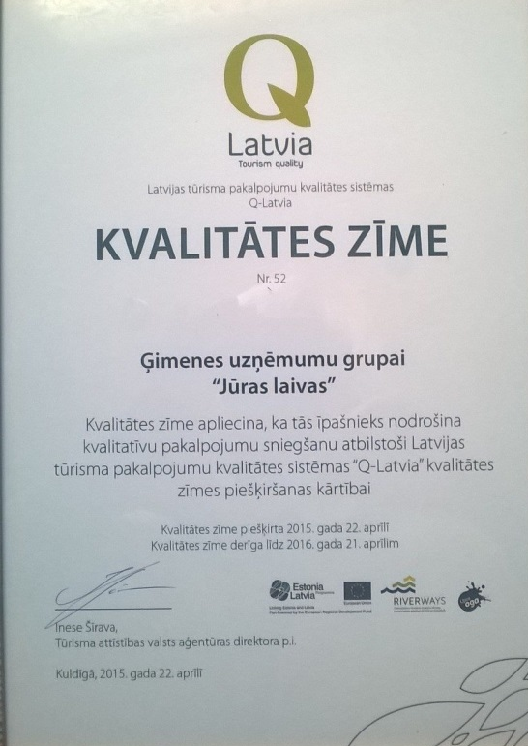
Q-Latvia – tourism quality
30 companies tested via «Mystery Shopping» out of which 10 companies received highest points between 80 – 100 and were awarded with Q-Latvia quality certificate
Laivinieks.lv
Jeņču laivas

Slide 7
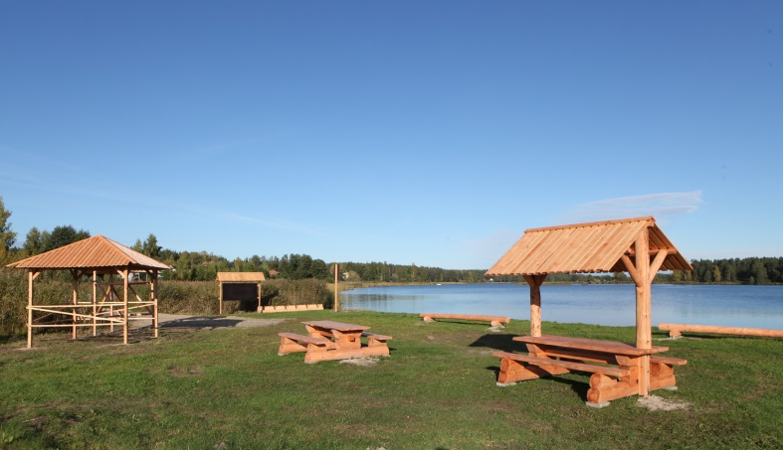
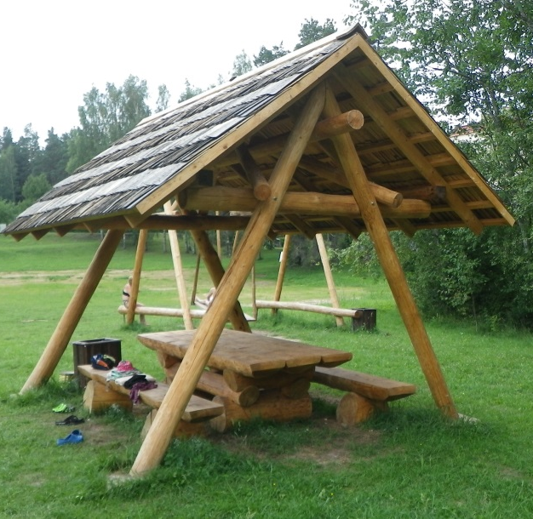
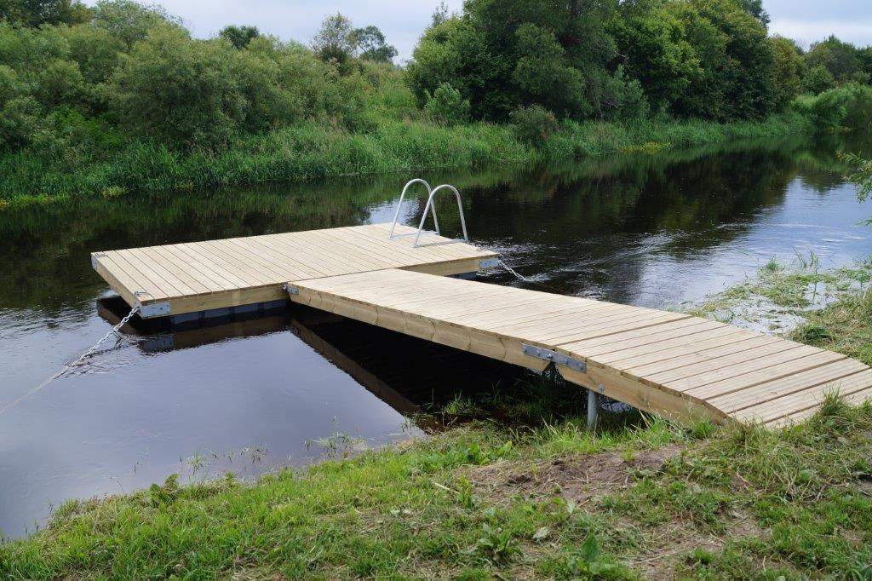
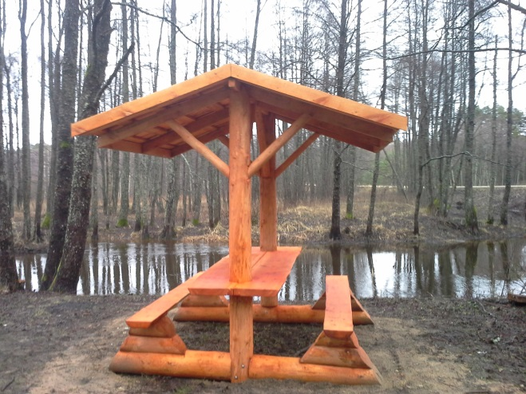
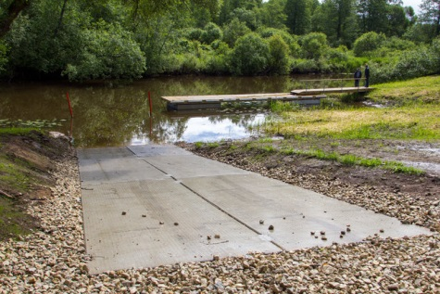
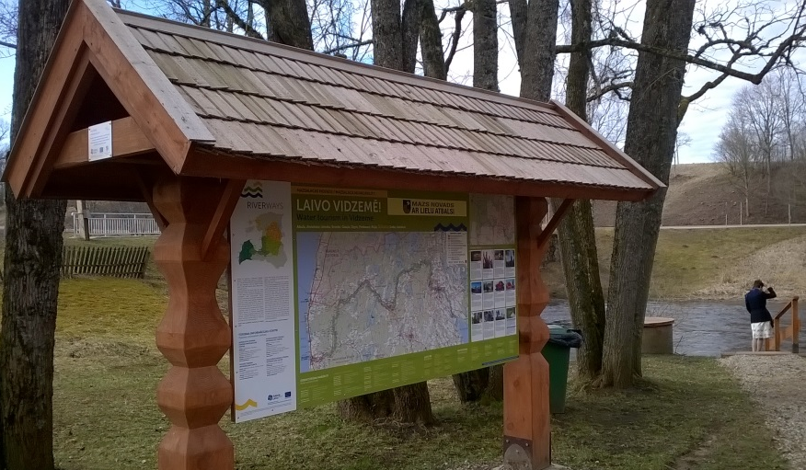
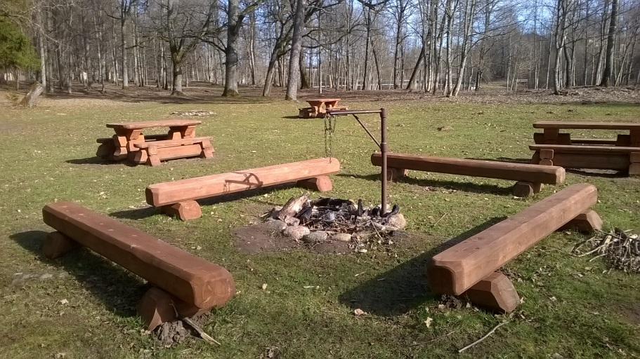
26 rivers;
Coastline in Lääne county;
3 lakes

Slide 8
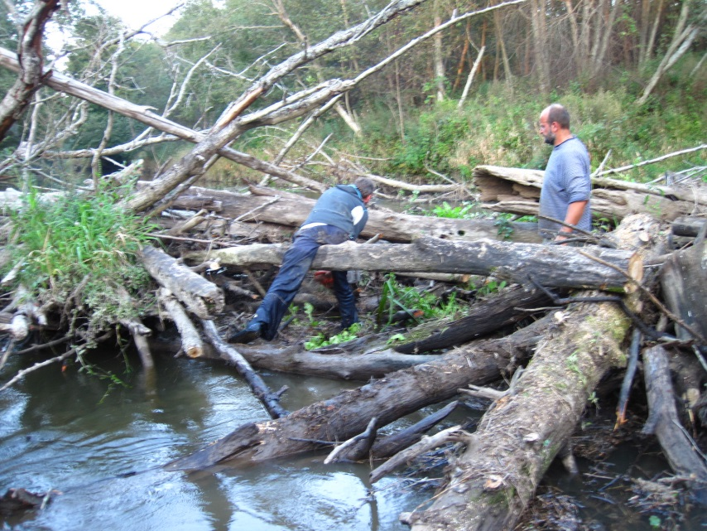
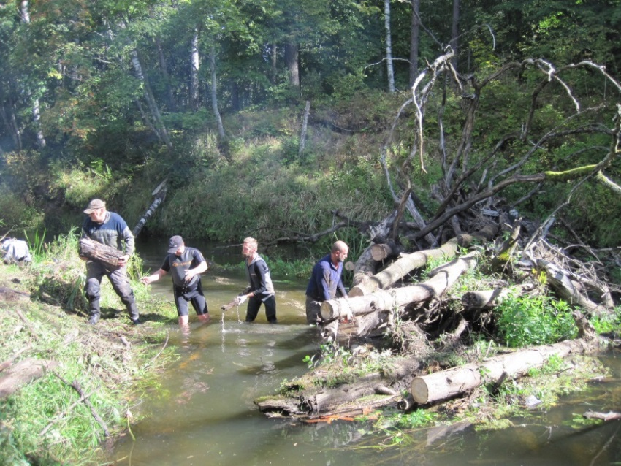
Cleaning of rivers
"Kõige tähtsam on leida paat!"
~ 312 km in 19 rivers;
9 spots along the rivers;

Slide 9
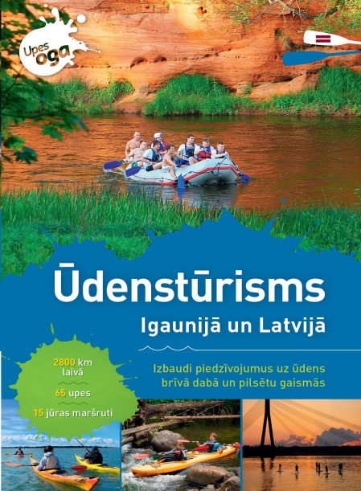
Marketing and promotion of watertourism
Image broshure: 80 000 copies in Estonian, Latvian, Russian, English, Finnish, Lithuanian and German languages
Coastal broshure
40 000 copies
Estonian, Latvian, English, Russian languages
Inserts in newspapers - Postimees and Diena to enocourage people take a kayaking holidays
7 Journalists visits – Germany, Russia, Lithuania, local media

Slide 10
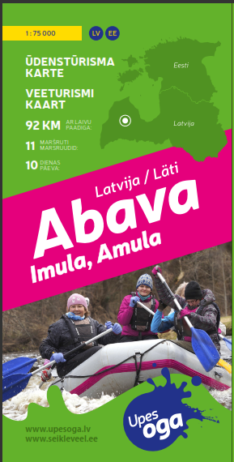
Detailed river guides – 46 detailed maps
Covering 65 rivers in total distance
of almoust 3000 km for kayaking, which is equal to ~ 150 days in canoe
Kasari Hapsalu bay Põltsamaa Mustjõgi Õhne Väike Emajõgi Elva Kooraste Võhandu Amme Haliste Kõpu Navesti Raudna Lemmjõgi Tänassilma Pärnu Svētupe Jaunupe Vitrupe Vecslocene Ogre Lielā Jugla Mazā Jugla Daugava Misa Ķekaviņa Brasla Salaca Abava Gauja Vaidava Amata Aiviekste Pededze Abuls Rūja Seda Briede Tebra Saka Durbe Venta Imula Amula Roja Bārta Vārtāja Užava Engure Rinda Stende Irbe Rīva Liepājas Fortress Channel, Sķēde, Ēda

Slide 11
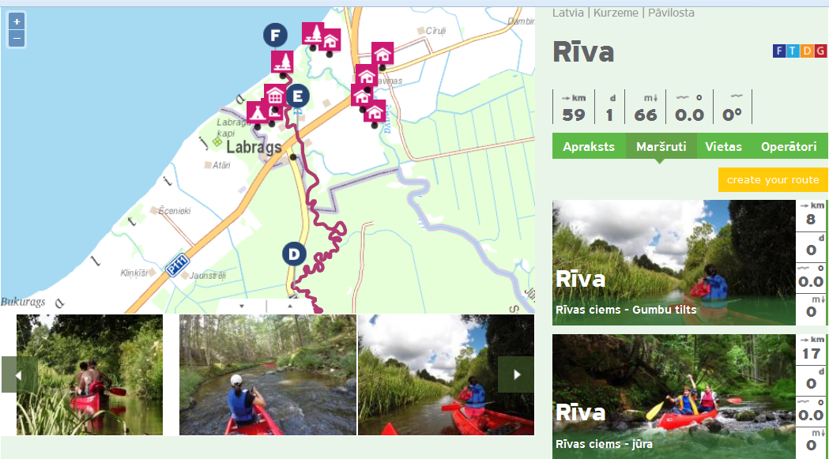
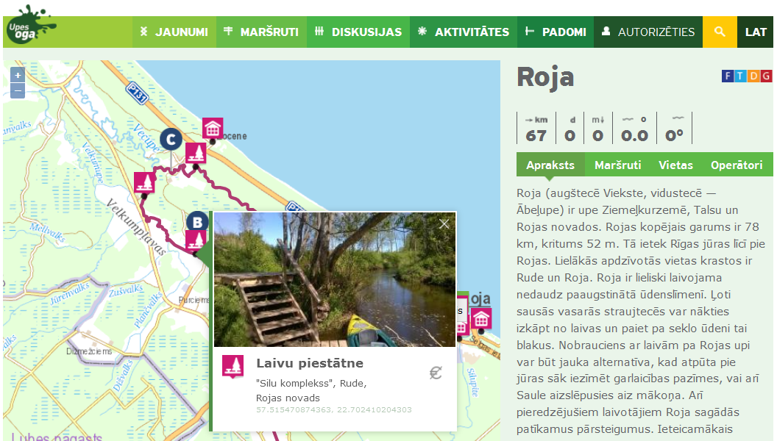
www.seikleveel.ee www.upesoga.lv
Rivers, coast, channels
Routes
Access points to rivers
Sites
Watertourism operators

Slide 12
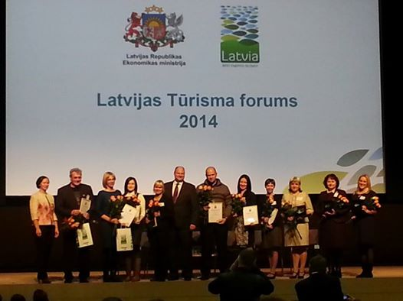
We are proud of success
Category «Latvian tourism product» - «Rivers of Vidzeme» – 1st Prize
(135 films from 33 countries)
Latvian tourism development agency award «New tourism product 2014» –
«Misa River canoe route» developed by Ķekava TIC and watertourism company «Jeņču laivas»

Slide 13
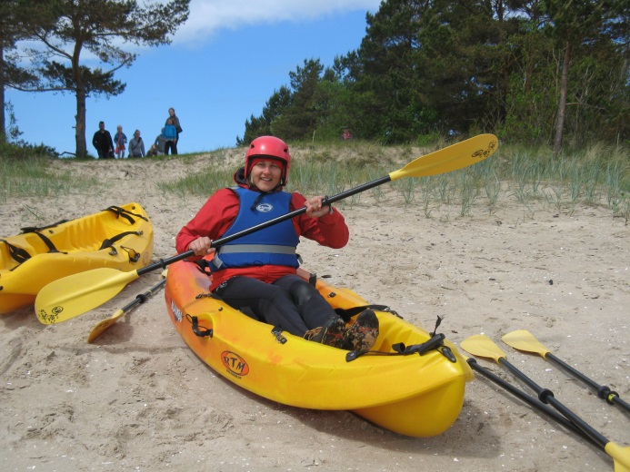
Laivošana ir kas tāds, ko ikvienam vajadzētu izmēģināt kaut reizi dzīvē!
Süstasõit on midagi sellist, mida igaüks peaks vähemasti korra elus proovima!
Meet you in the kayak!
Aiga Petkēvica
aiga.petkevica@kurzemesregions.lv.
Phone + 371 29483674
"Kõige tähtsam on leida paat!"

